Slide 1
Systematic ESG MUNI Alpha Research
Pankaj Kumar
R&I, SFI
Jan 2022

Slide 2
Outline
MUNI ESG Research
MUNI Bond Market Overview
Sensibility/Challenges with MUNI ESG
ESG Research
Explored Datasets Summary
Clarity AI Scores
ESG Insights
Appendix

Slide 3
Executive Summary
Objective
To explore ESG insights in the MUNI space as a return driver and/or ESG impact which can be eventually combined with Style Factor research to create a ESG MUNI factor model.
Challenges
Lack of standardization in the ESG space
MUNIs – Multi level Issuers
Lack of model/optimizer
Approach
Explored datasets to identify ESG metrics which are:
backed with sensibility,
High coverage of the benchmark,
updated regularly and
consistent.

Slide 4
MUNI ESG Overview

Slide 5
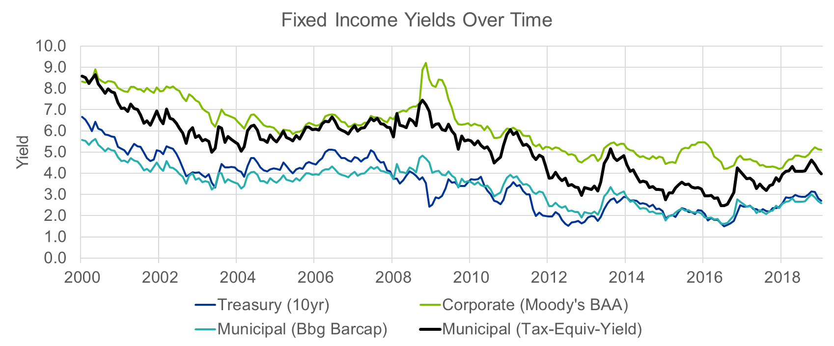
Municipal Bond Market Overview
A municipal bond is a debt security issued by a state, municipality, or county to finance its capital expenditures, including the construction of highways, bridges or schools. It can be classified as GO (general obligation - backed by government entities) or revenue (backed by revenue from a specific project).
The size of the U.S. municipal bond market is around $3.85 trillion, but there is not much active investment. The typical municipal bond investor is a buy-and-hold retail investor (42%), so trading intensity is very low.
Compared with U.S. Treasuries, municipal bonds are: 1) riskier, 2) less liquid, and 3) tax-exempt. As such, the “muni spread” is primarily comprised of default risk, liquidity risk, and taxation components (Ang, Bhansali, and Xing 2014).

Slide 6
ESG Research in MUNIs
Sensibility
Natural vehicle for ESG impact
Federal Focus - Shifting priorities at the federal level, where the administration has shown increased ambition to tackle climate change and boost infrastructure projects, many of which are funded by state and local governments.
Regulatory - ESG regulations are already active in EMEA and will become increasingly effective globally.
Structural Shift in Investing - Changing sensibility of millennial investors, pension funds and asset managers, is leading to a structural shift in the investing landscape and record flows into ESG.
Client Materiality - A growing interest from Clients in sustainable investing and divestment initiatives.
Challenges
Federal Support - Assessing factors relevant to MUNIs is more nuanced. Topics such as physical or transition climate risk and inequality are similar for munis and other sub-asset classes, however munis may benefit from federal or state support, potentially mitigating the effect on valuations. May not continue in the future.
MUNI Risk - Risks vary with the type of muni bond. Munis can at times resemble sovereign borrowers and at times corporate issuers
Data - For governance and social factors data is plentiful and often free but not disseminated effectively; for environmental factors it is still insufficient. Moreover, some issuers lack the necessary resources or perceive disclosure as a burden rather than a benefit to risk management and borrowing costs. Data is sometimes available on a state level, county level or obligor level.

Slide 7
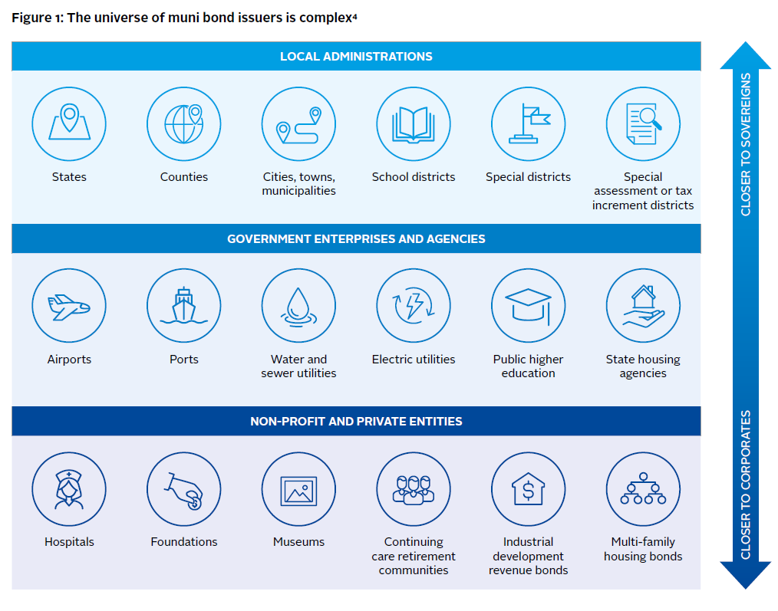
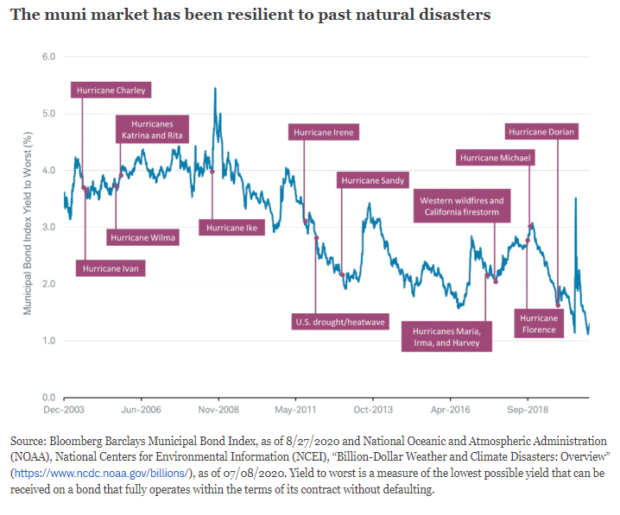
Challenges with ESG MUNI Research

Slide 8
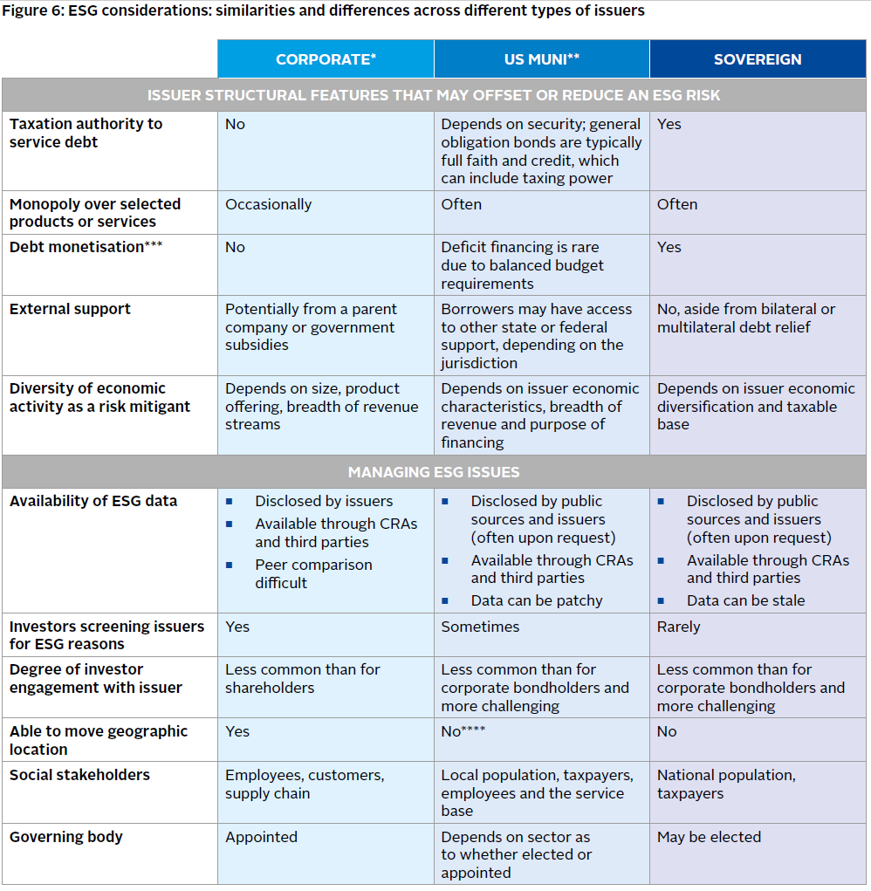
ESG Considerations in MUNIs

Slide 9
Data

Slide 10
Benchmark Summary Statistics
Ratings Groups:
Key States and Sectors:
 | % of Market | # of Issues | cur_face | model_duration | oas | ytm | ytw | ttm
AAA | 13.64% | 1721.9 | 86.3 | 5.9 | 3.4 | 2.4 | 1.7 | 12.7
AA | 56.66% | 6550.8 | 101.7 | 6.2 | 12.0 | 2.8 | 1.8 | 14.3
A | 23.93% | 2521.2 | 126.2 | 6.7 | 41.4 | 3.3 | 2.3 | 16.2
BBB | 5.14% | 435.2 | 174.6 | 7.3 | 110.4 | 3.9 | 3.1 | 16.9
BB | 0.02% | 2.7 | 77.1 | 3.2 | 37.9 | 2.9 | 1.6 | 20.1
B | 0.01% | 1.0 | 102.0 | 0.2 | 43.2 | 0.5 | 0.5 | 22.2
 | % of Market | # of Issuers | cur_face | model_duration | oas | ytm | ytw | ttm
CA | 21.2% | 2096.4 | 150.3 | 6.4 | 10.1 | 2.9 | 1.8 | 15.3
NY | 20.7% | 2214.4 | 115.1 | 6.3 | 16.2 | 3.1 | 1.9 | 14.9
TX | 8.9% | 1002.6 | 113.2 | 6.8 | 20.0 | 3.1 | 2.0 | 17.6
NJ | 5.4% | 465.7 | 137.1 | 6.6 | 74.6 | 3.2 | 2.6 | 12.2
MA | 4.9% | 548.8 | 95.6 | 6.4 | 9.3 | 2.5 | 1.8 | 13.8
 | % of Market | # of Issuers | cur_face | model_duration | oas | ytm | ytw | ttm
States & Territories | 23.8% | 2685 | 123.0 | 5.2 | 18.3 | 2.5 | 1.7 | 10.6
Financing & Development | 11.7% | 1184 | 128.1 | 6.3 | 44.5 | 3.1 | 2.2 | 14.1
Toll Roads | 10.2% | 866 | 170.0 | 6.9 | 33.0 | 3.1 | 2.2 | 17.6
Water & Sewer | 9.3% | 1036 | 97.0 | 6.8 | 12.3 | 3.3 | 2.0 | 18.7
Special Tax Districts | 9.1% | 1119 | 81.2 | 6.8 | 15.3 | 3.0 | 2.0 | 13.7

Slide 11
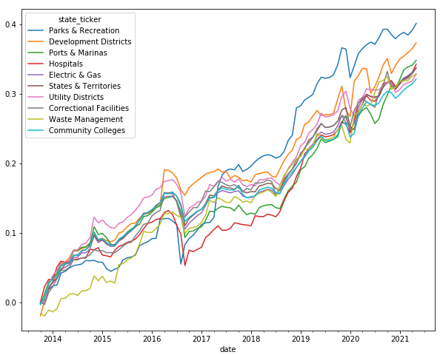
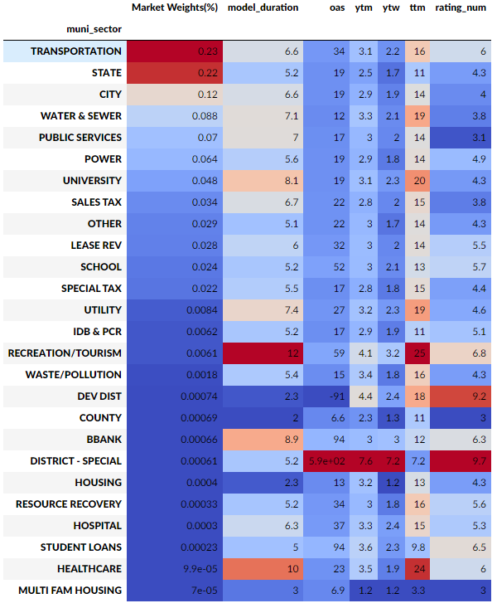
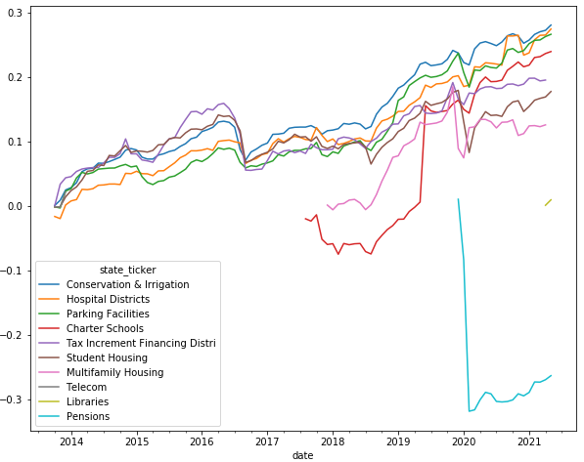
Summary Statistics

Slide 12
ESG Dataset Summary

Slide 13
ESG Datasets Summary
ESG Pillar | Dataset(s) | Description | Sensibility | Period Range | Use(s)
ESG | Clarity AI | ESG Score Provider like MSCI | States with higher scores should have good correlation with other ESG signals | No historical scores | ESG Score Uplift Ancillary Testing
E | EIA(Carbon Emissions Efficiency) | Carbon emissions for States (Annual) Carbon Emissions per GDP (Metric Ton per Million dollars) Carbon Emission per Capita (Metric Ton per million people) | Munis that are have higher carbon emission efficiency should outperform in the long run. The challenge is unlike corporates, States/MUNIs don’t have a direct control on carbon emissions | 2000-2018 | Ancillary Testing
E | Carbon Monitor/ BEA | Carbon emissions for States (Daily) Carbon Monitor: Daily Carbon Emissions Data collected using from many government org. and NGO.. (Carbon Emissions as metric tons) BEA: Economic data source like GDP | A much more accurate and timely (updated daily) source for carbon emissions | 2019 – 2021 | Ancillary Testing Too short of a history to use
E | EIA (Green Energy Production or Consumption) | % Green Energy for States (Annual) % of Green Energy Production % of Green Energy Consumption | Munis with very strong preference for Renewable energy production and consumption characteristics should outperform in the long run and should reflect State Policy contribution | 2000-2019 | Ancillary Testing
E | % Green Debt (BAMK/BBG) | % Mkt value of Green Debt/ Total Debt | Issuers that issue more green debt relative to others tend to be more efficient and should outperform in the long run | 2013-2021 | Ancillary Testing Not enough coverage to make statistically significant conclusions % Green Debt Uplift
E | ACEEE State Energy Efficiency Scores | State Energy Efficiency Scorecard analyzes the energy efficiency efforts by tracking their policies and programs to reduce energy use, such as adopting or advancing energy-saving targets, vehicle rules, or appliance standards. | States with higher Energy Efficiency scores are better prepared for low carbon transition and the potential financial impacts of climate change. While carbon emissions are not in direct control of states/munis, carbon transition policies are. | 2008-2020 | Potential Alpha Signal ESG Transition Metric

Slide 14
ESG Datasets Summary
ESG Pillar | Dataset(s) | Description | Sensibility | Period Range | Use(s)
S | County Health Ratings | Health Outcomes (Mortality, Morbidity) Health Factors (Health Behaviors, Clinical Care, Social and Economic Environment and Physical Environment) | Munis which spend relatively higher on Social Benefits responsibly should see improvement in social outcomes and eventually better financials | 2010-2021 | Ancillary Testing
S | Racial Equity (BSI) | Justice (Voting, Equal enforcement of the law, Police accountability) Opportunity (Education, Healthcare, Housing, Employment, Financing) | Munis which spend relatively higher on Opportunity and Justice should results improvement less discrimination and eventually better financials | No History | Ancillary Testing Not enough history
S | Ground Transportation | This dataset covers a range of metrics: Highway Fatalities, Highway use of gasoline, Highway vehicle-miles traveled, Licensed drivers, Person miles, Person trips, Persons traveling, Transit Ridership, Vehicles | Munis which spend relatively higher on Green Infrastructure resulting in improvement of these metrics should result in better returns and eventually better financials | 2009-2019 | Ancillary Testing Lacks direct sensibility
S | Mapping Police Violence | This dataset has been meticulously sourced from official police use of force data collection programs combined with national data from the fatal encounter database. | Police brutality should be a function of poor governance, social benefits and possibly financial health. | 2013-2021 | Potential Alpha Signal Ancillary Testing
S | Human Rights Campaign | This score examines how inclusive municipal laws, policies, and services are of LGBTQ+ people who live and work there. Counties are rated based on non-discrimination laws, the municipality as an employer, municipal services, law enforcement and leadership on LGBTQ+ equality. | States with relatively higher score on human rights should result in better returns with direct societal outcome. Since the score measures policies, it’s a direct ESG measure for MUNIs. | Annual starting 2021 | Social Score Uplift Ancillary Testing

Slide 15
ESG Datasets
ESG Pillar | Dataset(s) | Description | Sensibility | Period Range | Use(s)
G | BitSight | Cybersecurity risk security rating | A higher cybersecurity rating signifies better governance on a state and obligor level | 2015-2021 | Ancillary Testing Potential Alpha Signal
G | MFRA (Moodys) | Moody’s comprehensive database of standardized and comparable financial and operating data points on U.S. Municipal issuers across many sectors | Muni Bonds performing relatively good on these metrics should have better performance | 2008-2021 Highly skewed datapoints | Ancillary Testing Potential Alpha Signal

Slide 16
ESG Insights

Slide 17
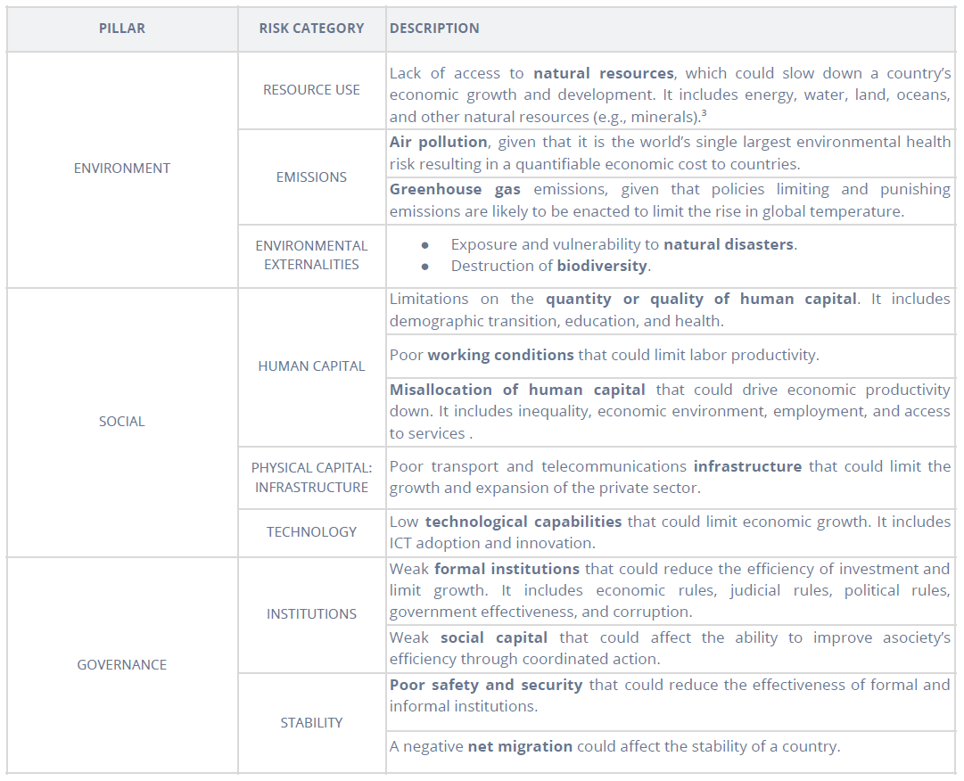
Clarity AI ESG Scores
Blackrock recently acquired Clarity AI which covers Corporates and Sovereigns.
Similar to MSCI, Clarity AI rates all issuers on three pillars and 8 sub- pillars.
Currently only covers US States.
We aim to use it for ESG risk reporting and as an uplift constraint.

Slide 18
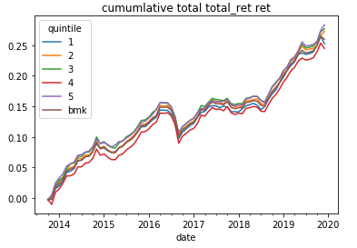
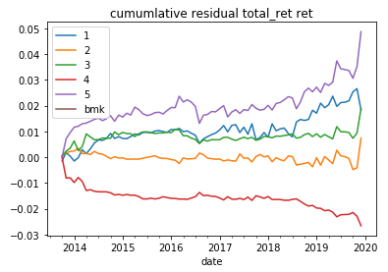
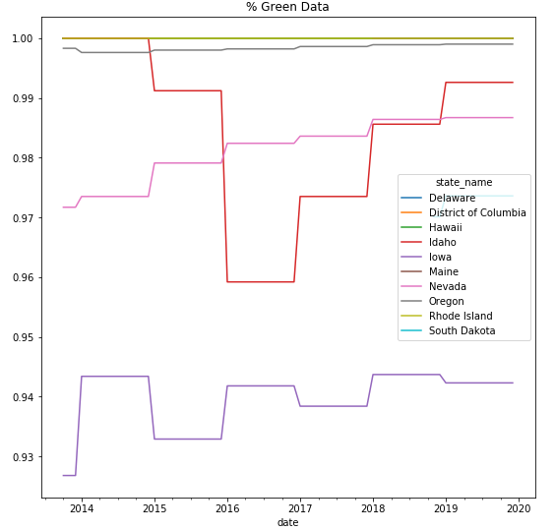
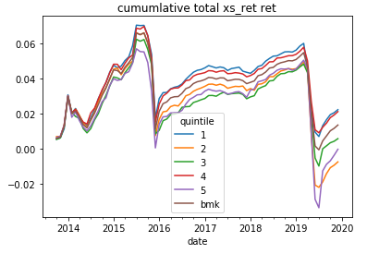
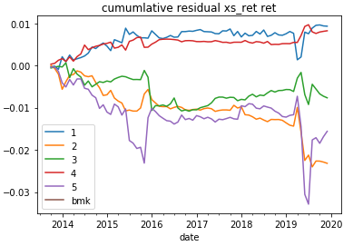
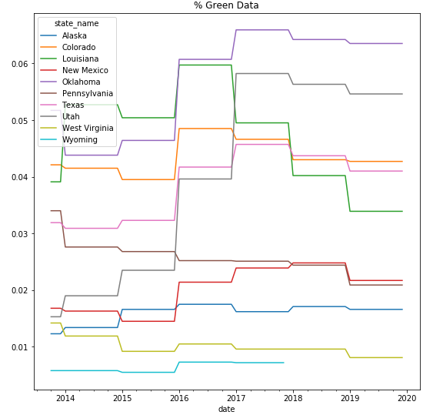
EPA - % Green Energy Production
Sensibility | Higher score states tend shows preference towards Increasing Green Production and hence act as a direct Environment Impact measure
Signal Construction | % Renewable Energy Production/Total Energy Production
Comments | Can be used as ancillary for policy signal

Slide 19
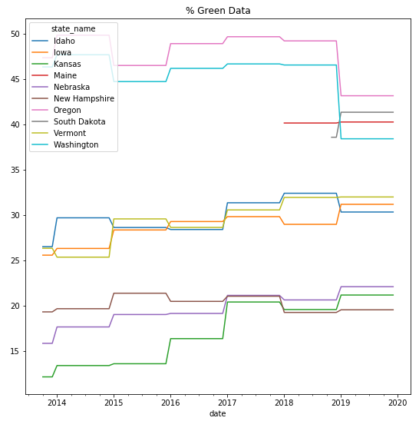
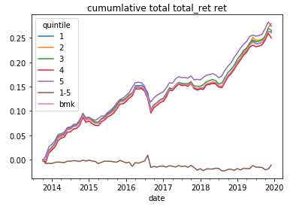
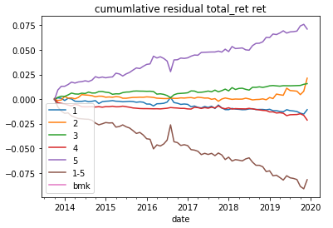
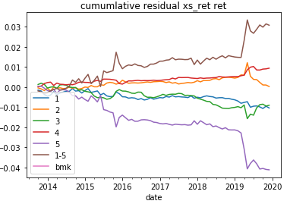
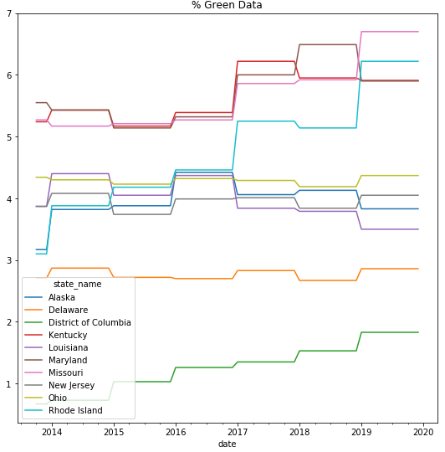
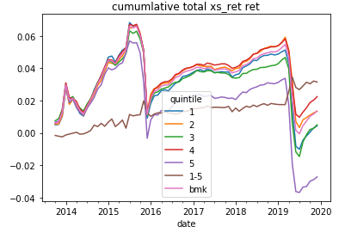
EPA - % Green Energy Consumption
Sensibility | Higher score states tend shows preference towards Increasing Green Consumption and hence act as a direct Environment Impact measure
Signal Construction | % Renewable Energy Consumption/Total Energy Consumption
Comments | Can be used as ancillary for policy signal

Slide 20
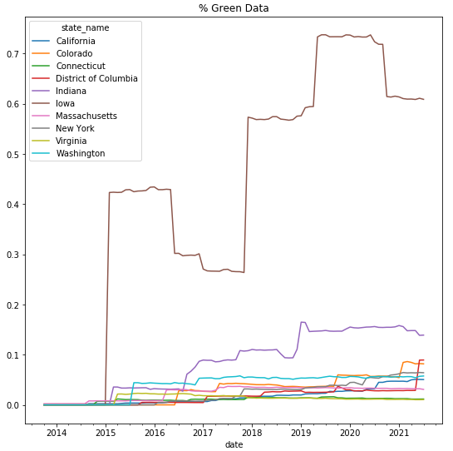
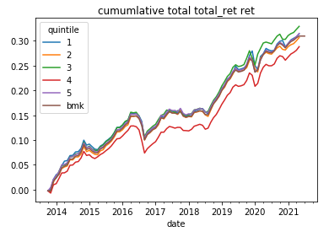
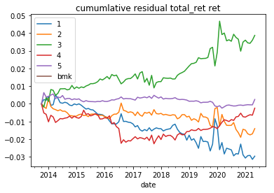
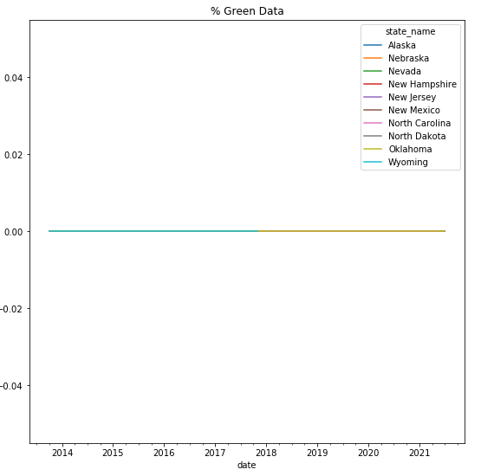
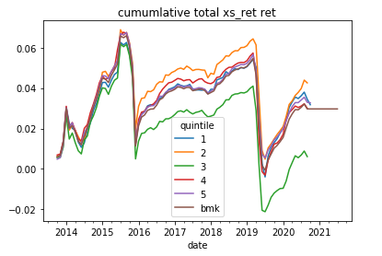
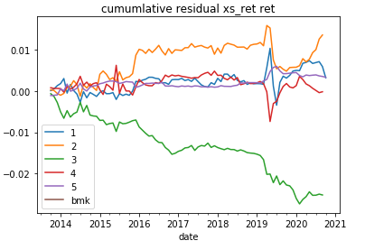
% Green Debt
Sensibility | Captures the value as Green debt are the direct measure of ESG Impact
Signal Construction | % of Green Debt Market Value/Total Market Value
Comments | We expect to confirm ESG Impact from use of proceeds by second party opinion(BNEP) data. % Green Debt can be used as a uplift constraint

Slide 21
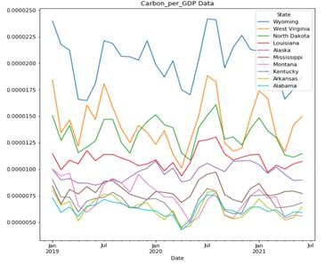
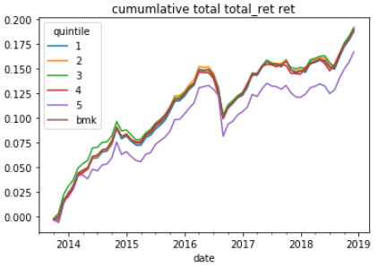
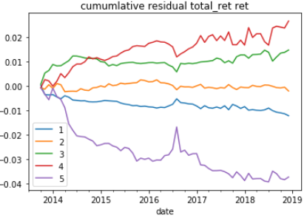
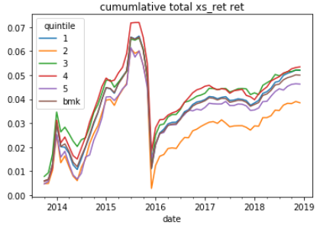
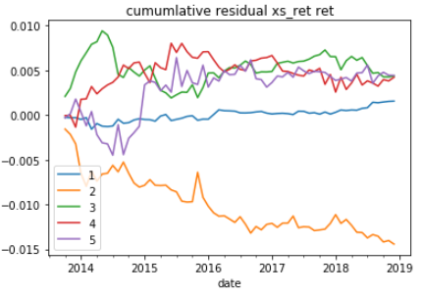
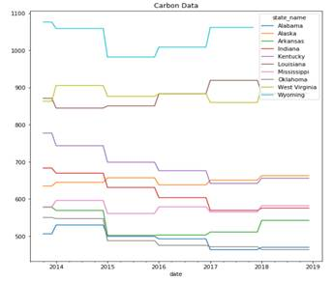
Carbon Emissions Per GDP
Sensibility | Captures the relative value as carbon intensity are the direct measure of ESG Impact
Signal Construction | Carbon Emission Monthly sum value/Forward filled quarterly GDP
Comments | Not a direct ESG measure

Slide 22
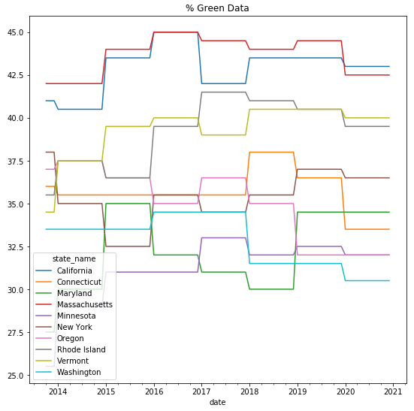
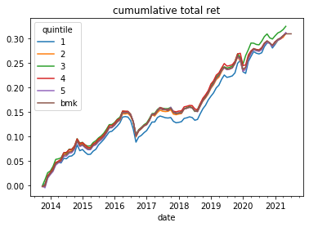
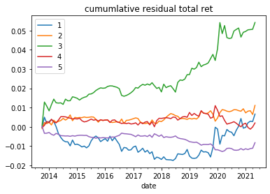
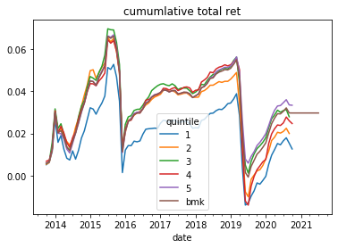
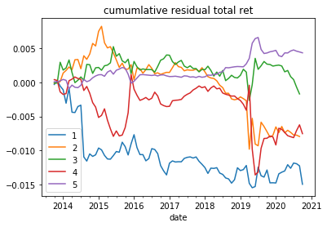
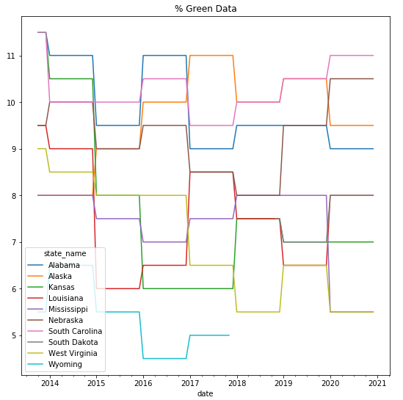
ACEEE State Energy Efficiency Scores
Sensibility | State’s score reflect policy implementation on previous year
Signal Construction | Evaluation of states given by Industry experts on policy implementation
Comments | A direct ESG measure since its policy driven

Slide 23
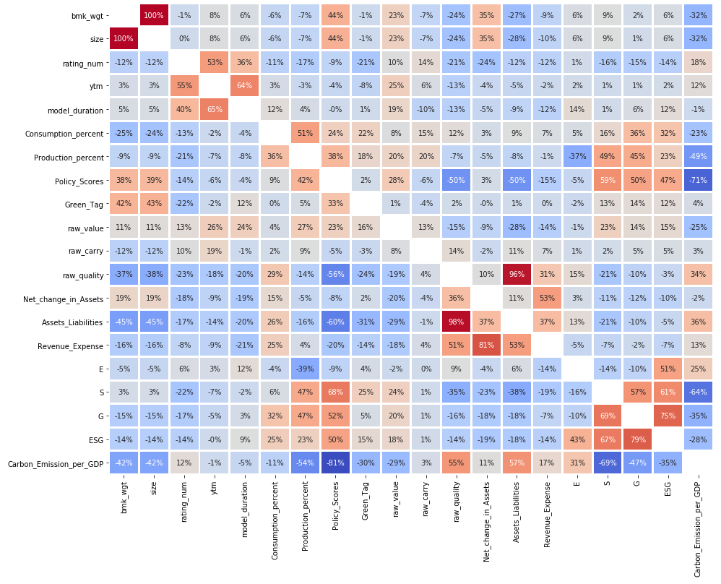
State Green Policy Signal Correlation

Slide 24
State Green Policy Signal Performance
Total Returns
Excess Returns
 | 1 | 2 | 3 | 4 | 5 | bmk
Total Return | 3.86% | 4.05% | 4.24% | 4.05% | 4.07% | 3.95%
Total Vol | 2.72% | 2.58% | 2.48% | 2.66% | 2.73% | 2.60%
SR | 1.49 | 1.57 | 1.71 | 1.53 | 1.49 | 1.52
Alpha | 0.09% | 0.15% | 0.71% | 0.03% | -0.11% | NaN
Beta | 0.98 | 0.97 | 0.87 | 1.00 | 1.03 | NaN
Beta Adjusted IR | 0.10 | 0.32 | 0.75 | 0.06 | -0.41 | NaN
model_duration | 6.48 | 5.97 | 6.38 | 6.49 | 6.22 | 6.30
ytw | 2.07 | 1.87 | 2.10 | 2.26 | 1.84 | 1.97
rating_num | 4.96 | 4.25 | 4.78 | 5.88 | 4.16 | 4.65
Green_Tag | 1.11% | 0.42% | 0.24% | 0.82% | 1.67% | 1.26%
raw_value | 0.02 | -0.02 | -0.03 | 0.02 | 0.08 | 0.04
raw_carry | 5.23 | 4.92 | 4.48 | 4.77 | 4.82 | 4.77
raw_quality | 1.89 | 1.77 | 1.59 | 1.05 | 0.99 | 1.19
Consumption_percent | 9.37 | 8.53 | 6.72 | 6.91 | 14.00 | 10.90
Production_percent | 22.90% | 33.44% | 21.25% | 21.87% | 46.23% | 35.65%
Net_change_in_Assets | 973.93 | 3501.42 | 5699.15 | -1470.07 | 4773.52 | 3569.51
Assets_Liabilities | 2.74 | 2.45 | 2.23 | 1.08 | 1.01 | 1.39
Revenue_Expense | 1.04 | 1.05 | 1.05 | 0.99 | 1.02 | 1.02
E | 46.77 | 48.88 | 45.07 | 51.99 | 51.60 | 50.30
S | 58.27 | 59.83 | 60.88 | 63.91 | 64.75 | 63.44
G | 68.50 | 69.48 | 70.77 | 71.35 | 74.22 | 72.58
ESG | 60.64 | 62.10 | 61.98 | 64.77 | 66.02 | 64.68
hrc_score | 48.70 | 59.04 | 65.12 | 79.61 | 81.58 | 75.84
Carbon_Emission_per_GDP | 539.08 | 385.59 | 341.65 | 267.50 | 153.15 | 237.56
security_rating | 519.18 | 527.39 | 559.45 | 553.71 | 548.42 | 548.47
 | 1 | 2 | 3 | 4 | 5 | bmk
Total Return | 0.18% | 0.29% | 0.40% | 0.35% | 0.47% | 0.38%
Total Vol | 2.24% | 2.27% | 2.39% | 2.61% | 2.30% | 2.23%
SR | 0.08 | 0.13 | 0.17 | 0.13 | 0.20 | 0.17
Alpha | -0.21% | -0.11% | -0.02% | -0.11% | 0.06% | NaN
Beta | 0.93 | 0.94 | 1.00 | 1.09 | 0.98 | NaN
Beta Adjusted IR | -0.46 | -0.25 | -0.06 | -0.19 | 0.37 | NaN
model_duration | 6.48 | 5.97 | 6.38 | 6.49 | 6.22 | 6.30
ytw | 2.07 | 1.87 | 2.10 | 2.26 | 1.84 | 1.97
rating_num | 4.96 | 4.25 | 4.78 | 5.88 | 4.16 | 4.65
Green_Tag | 1.11% | 0.42% | 0.24% | 0.82% | 1.67% | 1.26%
raw_value | 0.02 | -0.02 | -0.03 | 0.02 | 0.08 | 0.04
raw_carry | 5.23 | 4.92 | 4.48 | 4.77 | 4.82 | 4.77
raw_quality | 1.89 | 1.77 | 1.59 | 1.05 | 0.99 | 1.19
Consumption_percent | 9.37 | 8.53 | 6.72 | 6.91 | 14.00 | 10.90
Production_percent | 0.23 | 0.33 | 0.21 | 0.22 | 0.46 | 0.36
Net_change_in_Assets | 973.93 | 3501.42 | 5699.15 | -1470.07 | 4773.52 | 3569.51
Assets_Liabilities | 2.74 | 2.45 | 2.23 | 1.08 | 1.01 | 1.39
Revenue_Expense | 1.04 | 1.05 | 1.05 | 0.99 | 1.02 | 1.02
E | 46.77 | 48.88 | 45.07 | 51.99 | 51.60 | 50.30
S | 58.27 | 59.83 | 60.88 | 63.91 | 64.75 | 63.44
G | 68.50 | 69.48 | 70.77 | 71.35 | 74.22 | 72.58
ESG | 60.64 | 62.10 | 61.98 | 64.77 | 66.02 | 64.68
hrc_score | 48.70 | 59.04 | 65.12 | 79.61 | 81.58 | 75.84
Carbon_Emission_per_GDP | 539.08 | 385.59 | 341.65 | 267.50 | 153.15 | 237.56
security_rating | 519.18 | 527.39 | 559.45 | 553.71 | 548.42 | 548.47
Figure 3

Slide 25
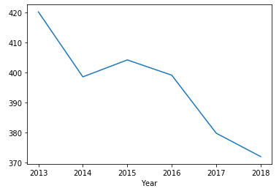
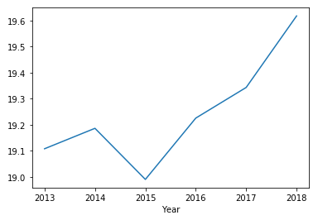
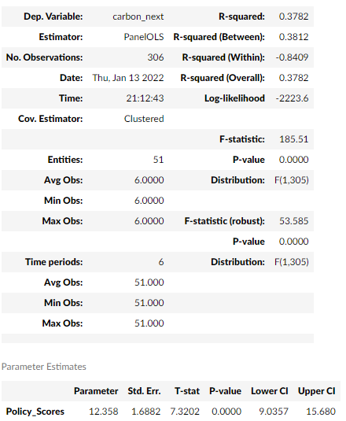
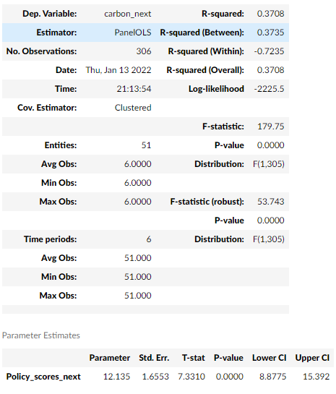
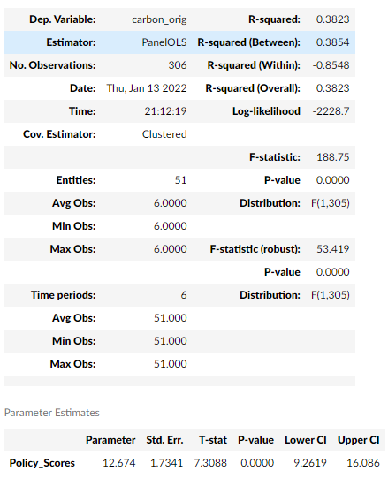
Finding the Double-Bottom Line Sustainable outcomes and alpha drivers for State Green Policy Signal
Investment Result: States with lowest Green Policy generally have lowest returns and can be a leading indicator for deterioration in state quality with lower performance.
Sustainable Result: High Carbon per GDP are generally associated with lower Green Policy scores and is a leading indicator of reduction in Carbon per GDP Scores
Trends of Carbon per GDP with Green Policy Score
Carbon per GDP Value with Time
Green Policy Scores with Time
Regressing Next carbon value using Policy Scores Current and Next
Panel Regressing carbon value using Policy Scores Current

Slide 26
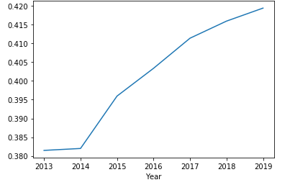
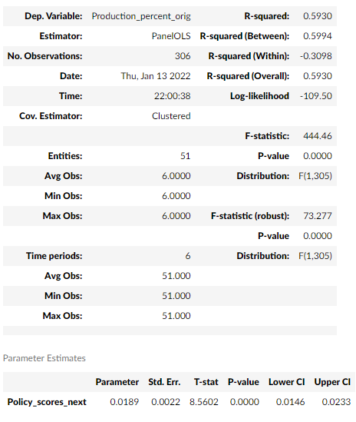
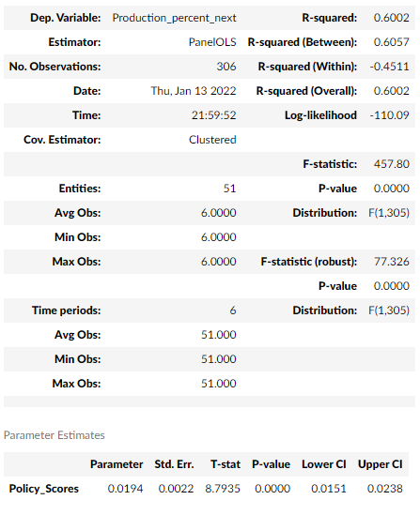
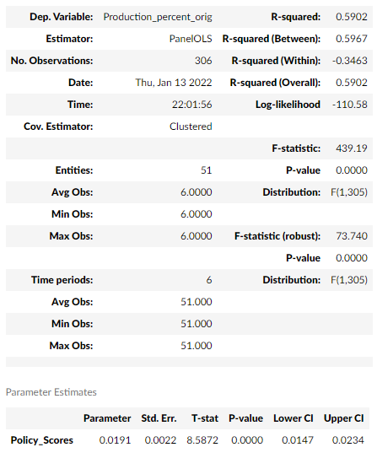
Finding the Double-Bottom Line Sustainable outcomes and alpha drivers for State Green Policy Signal
Trends of %Green Energy Production with Green Policy Score
Investment Result: States with lowest Green Policy generally have lowest returns and can be a leading indicator for deterioration in state quality with lower performance.
Sustainable Result: Higher % Green Energy Production are generally associated with Higher Green Policy scores and is a leading indicator of increment in Green Policy scores
%Green Energy Production with Time
Green Policy Scores with Time
Regressing Next Green Production using Policy Scores Current and Next
Panel Regressing %Green production using Policy Scores Current

Slide 27
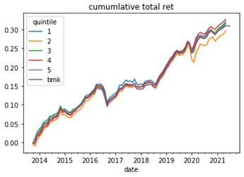
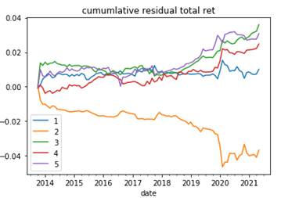




Ground Transportation
Sensibility | Less ratio per miles traveled indicates more safety measures which is directly related to societal outcome
Signal Construction | Ratio of Highway Fatalities to Highway miles travelled by vehicles
Comments | Not a direct ESG measure

Slide 28





County Health Rankings
Sensibility | Counties with higher scores tend to have higher social outcome with healthier people
Signal Construction | Contribution from Health Behaviors, Clinical Care, Social & Economic Factors, Physical Environment all of which are Quantitative factors
Comments | Can be used for Ancillary testing

Slide 29

Racial Equity
Sensibility | Measures racial equity for each county on access to Education, healthcare, housing etc.
Signal Construction | Counties are scores on Opportunity and Justice metrics for society
Comments

Slide 30







Cyber Security
Sensibility | Counties with higher scores tend to have higher governance
Signal Construction | Cyber security rating
Comments

Slide 31





University Level Revenue Driver
Sensibility | Creates differentiation between businesses of Public and Private Institutions and show excess returns
Signal Construction | % of Net Tuition Fees and Auxiliaries to Total Revenues
Comments

Slide 32
Appendix

Slide 33
Data Sources
Data Sources
BAML (single-name dataset from SNAP)
Aladdin MUB Dataset
EIA
BEA
ASCEE
Bureau of Transportation Statistics
County Health Rankings
Additional Data Sources
Bloomberg (state level financial statement data)

Slide 34

Appendix – Useful ESG Resources

Slide 35


Slide 36

What is a Municipal Bond?
Municipal Bonds are debt obligations issued by various government bodies and not-for-profit entities across the United States who use the loans to help finance their operations or fund public projects such as the construction of schools, highways, sewers, or power plants

Slide 37



Municipal Marketplace

Slide 38

Sectors of the Market

Slide 39


Slide 40


Slide 41


Slide 42


Slide 43


Slide 44


